Slide 1
The Disability Unit(DU)

Slide 2
The University of Johannesburg’s Disability Unit (DU) operates within the Centre for Psychological Services and Career Development (PsyCaD), and supports students with disabilities in the university setting. The DU’s support for students with disabilities includes providing advice and facilitating academic accommodations, in partnership with the students' university departments and faculty. The DU provides the following support services to students with disabilities (SwDs) across all four UJ campus sites:
Academic Support
To promote the academic success of students at the University of Johannesburg through making appropriate referrals
Concession applications for tests and exams
Technological Services
Provision of enlargements for study material, test and exam papers
The sourcing of electronic books from publishers
Editing, formatting and adapting text to facilitate the 'brailing' process
Assisting in Mobility training (for Visually impaired students) and campus orientation

Slide 3
Psychological support
Providing psychological, emotional and therapeutic support for students in need of such interventions
In addition, the DU also provides and/or assists with the Accessible computer spaces in the libraries and PsyCaD.
Libraries:
APK: Level 2,
APB: ground floor level 1,
DFC: ground floor level 1,
SWC: computer labs
PsyCaD offices
APK: C ring 119
APB: Impala court ground floor
DFC: House no. 5 next to the student centre
SWC: Adelaide Tambo building ground floor behind the library

Slide 4
The spaces have the following technology:
Computers,
Desktop magnifiers,
Eye-Pal solo book readers,
ZoomText magnifying software,
JAWS, NVDA and WINDOWS EYES,
Claro access suite,
WordQ + Speak Q
Read & Write gold/TextHelp
Large print keyboards
For more information, contact the University of Johannesburg’s Disability Unit:
Main Offices: Auckland Park Kingsway Campus APK, C Ring 1
Email: disabilityunit@uj.ac.za
Tel: 011 559 3745
Visit: www.uj.ac.za/PsyCaD
www.facebook.com/PsyCaD

Slide 5
In keeping with the times of remote learning, the DU is moving ONLINE.

Slide 6
All our services can now be applied for using the online application forms via Microsoft office.
The application forms are screen reader friendly, enlargeable and will ensure a quick and efficient turn around time in support request for all our students.
Students will use QR codes to access the forms on their mobile devices.
See the links and QR codes below:

Slide 7
For booking tests:
https://forms.office.com/r/644FJytkTa
For Coursework conversion:
https://forms.office.com/r/NQXvYYESbx
For Computer lab booking:
https://forms.office.com/r/VKeYC0iNtL
For Assistive technology training:
https://forms.office.com/r/LtSu7cK0JC
For Assistive device loans:
https://forms.office.com/r/nHHcstw6y6
For requesting the shuttle service:
https://forms.office.com/r/UhRDwfi6DJ
For requesting support:
https://forms.office.com/r/ak16HEwjQ5

Slide 8
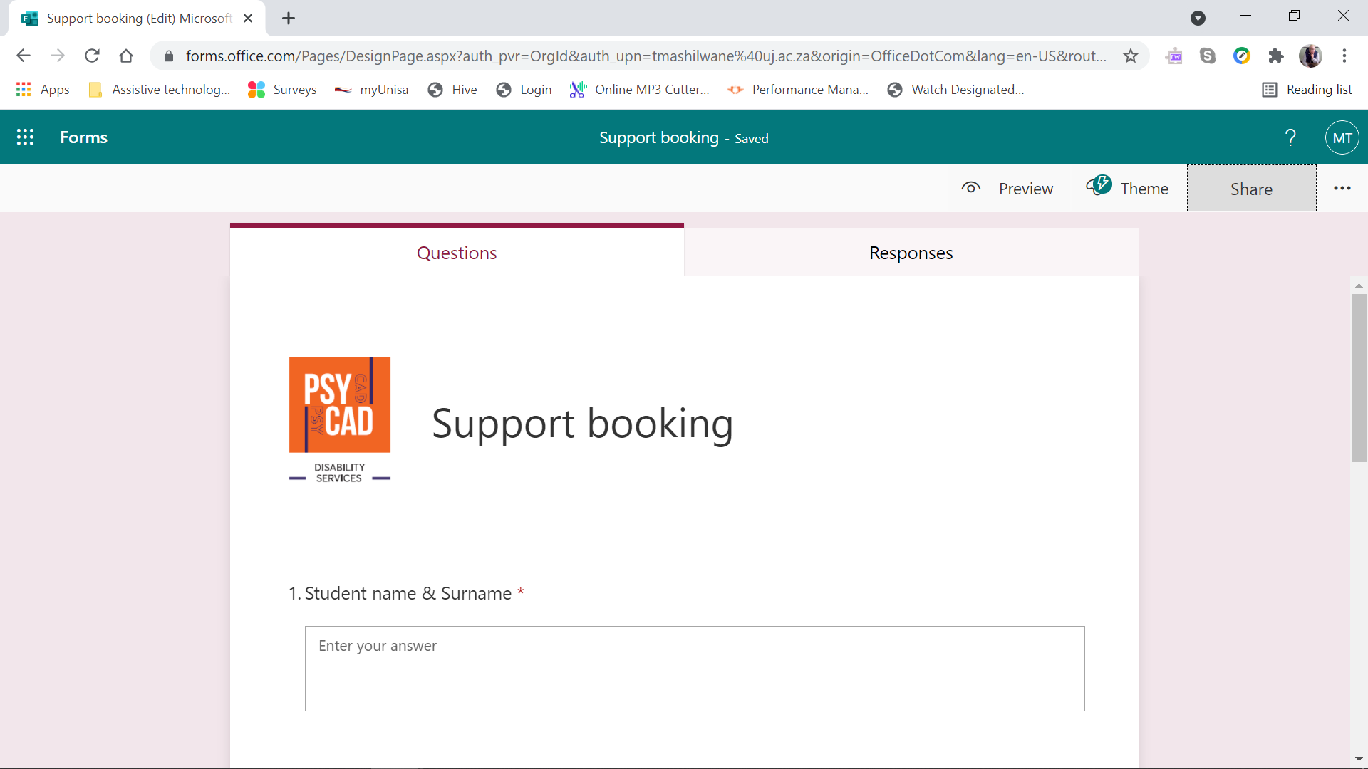
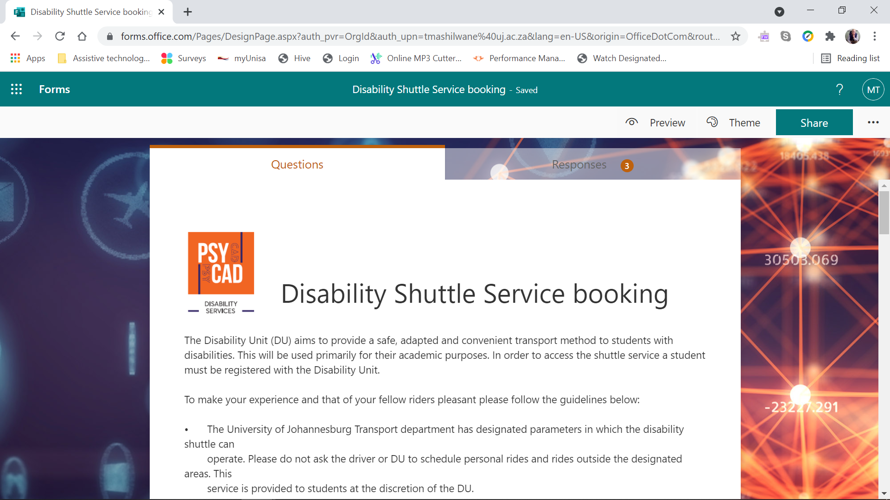
Shuttle request form example
Support request form example

Slide 9
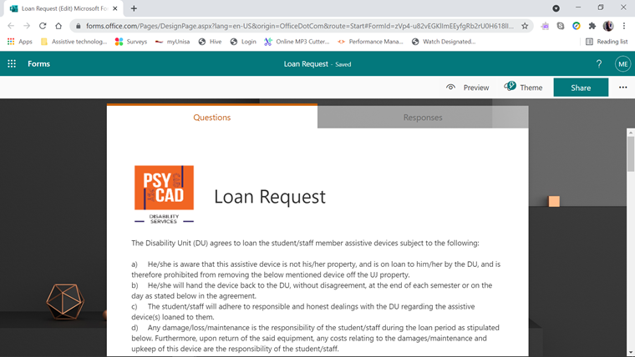
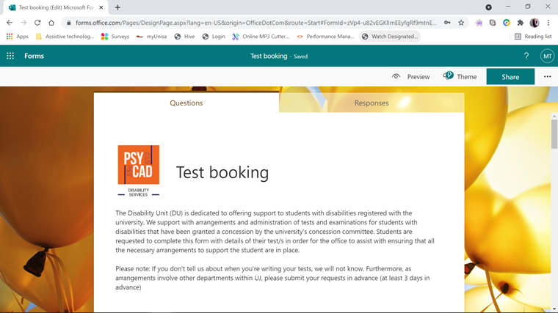
Test booking request form example
Loan request form example

Slide 10
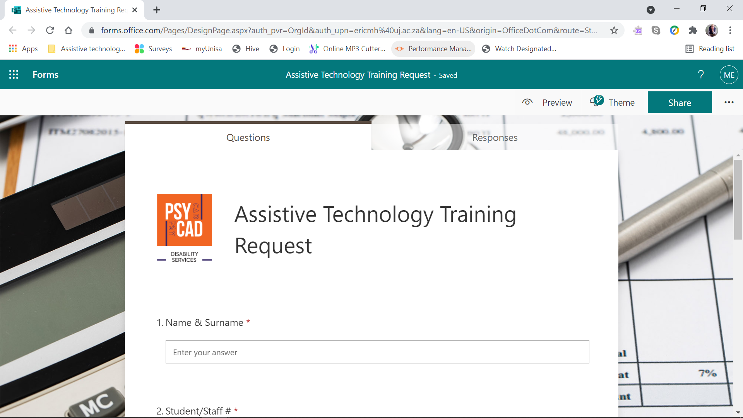
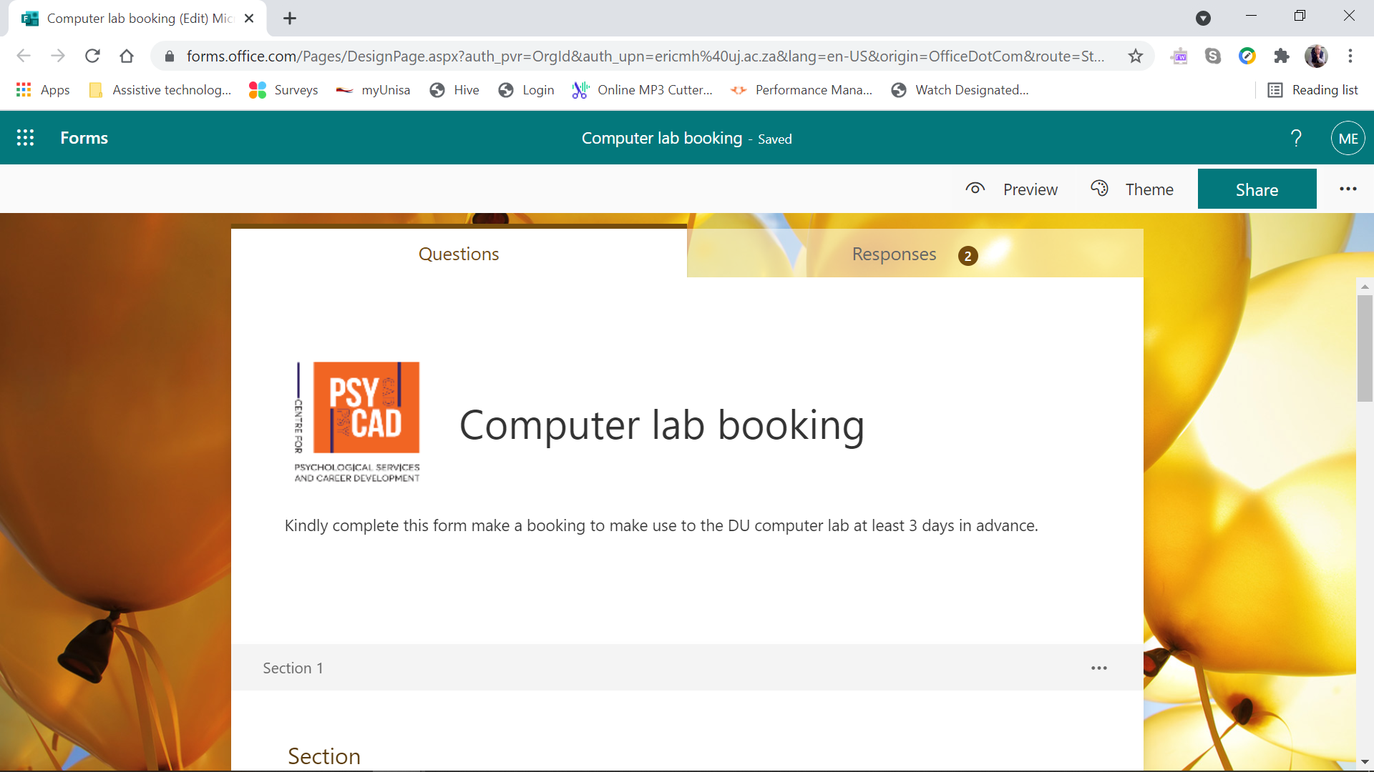
Assistive technology training request form example
Computer lab request form example

Slide 11
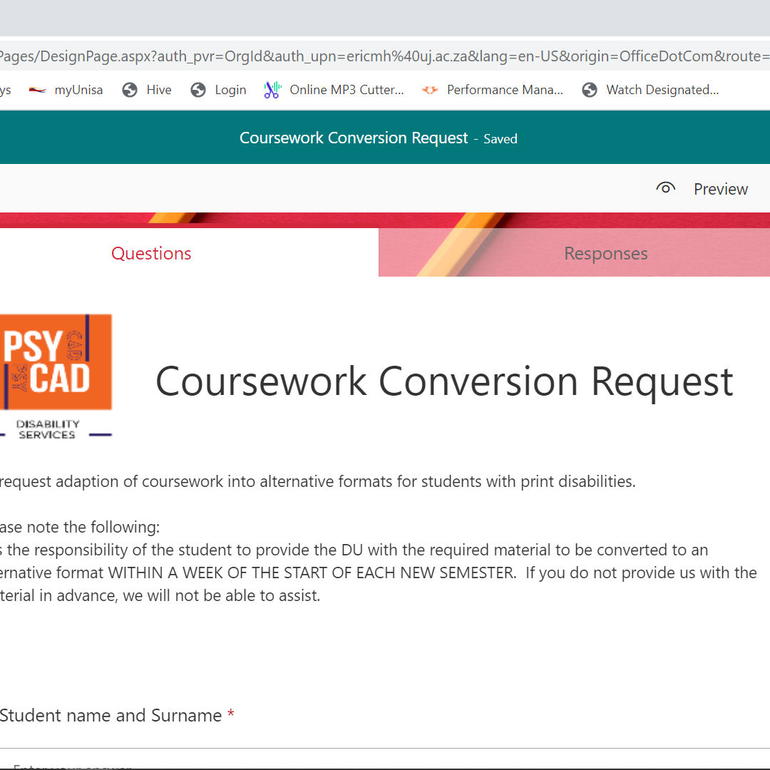
Coursework conversion request form example

Slide 12
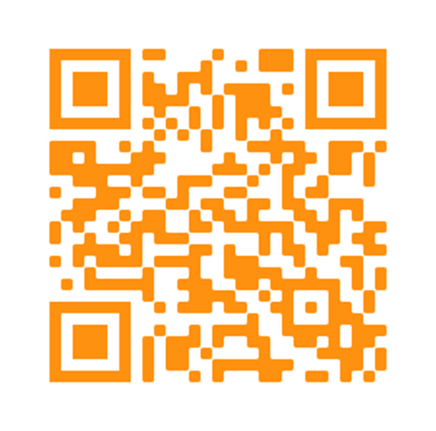
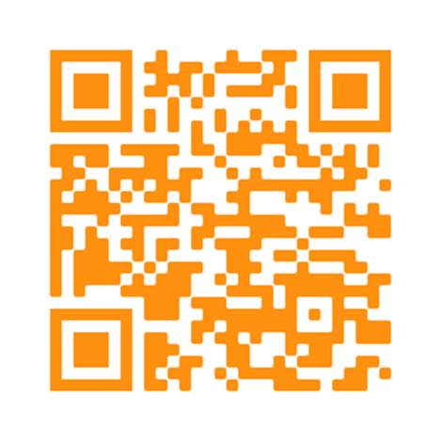
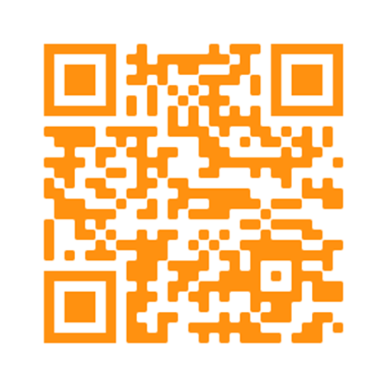
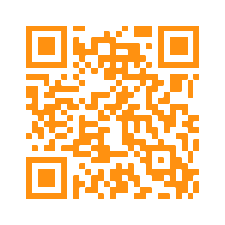
Coursework Adaption
Assistive technology training request
Q
R
C
O
D
E
S
Loan request
Computer lab request

