Slide 1
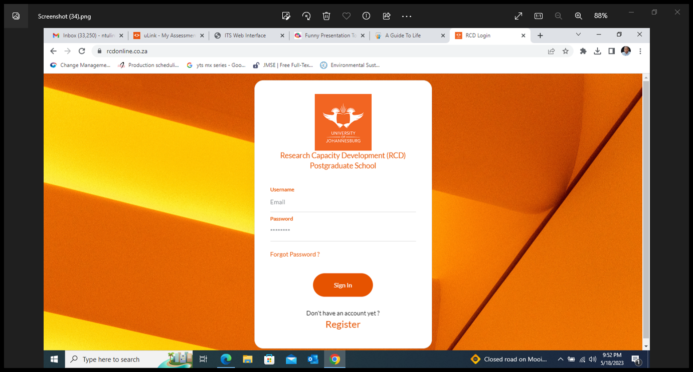
HOW TO REGISTER AND SUBMIT AN ENTRY FOR THE 3MT COMPETITION ON THE RCD MANAGEMENT SYSTEM

Slide 2
Ensure that you use Google Chrome or Microsoft Edge as your Internet Browser.
Go to https://rcdonline.co.za

Slide 3
3. Click on Register to create an account.

Slide 4
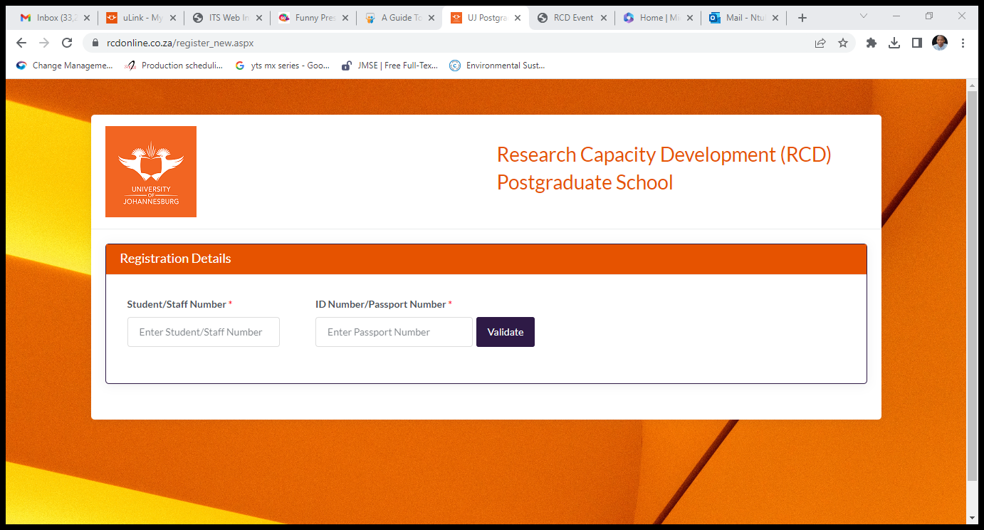
4. Enter your Student/Staff number and Id/Passport number to validate your details.

Slide 5
5. Create a password
6. Acknowledgment and consent: POPI Act (check the box)

Slide 6
7. Registration verification

Slide 7
8. Welcome to RCD (Check your email for your login details)

Slide 8
9. Sign in

Slide 9
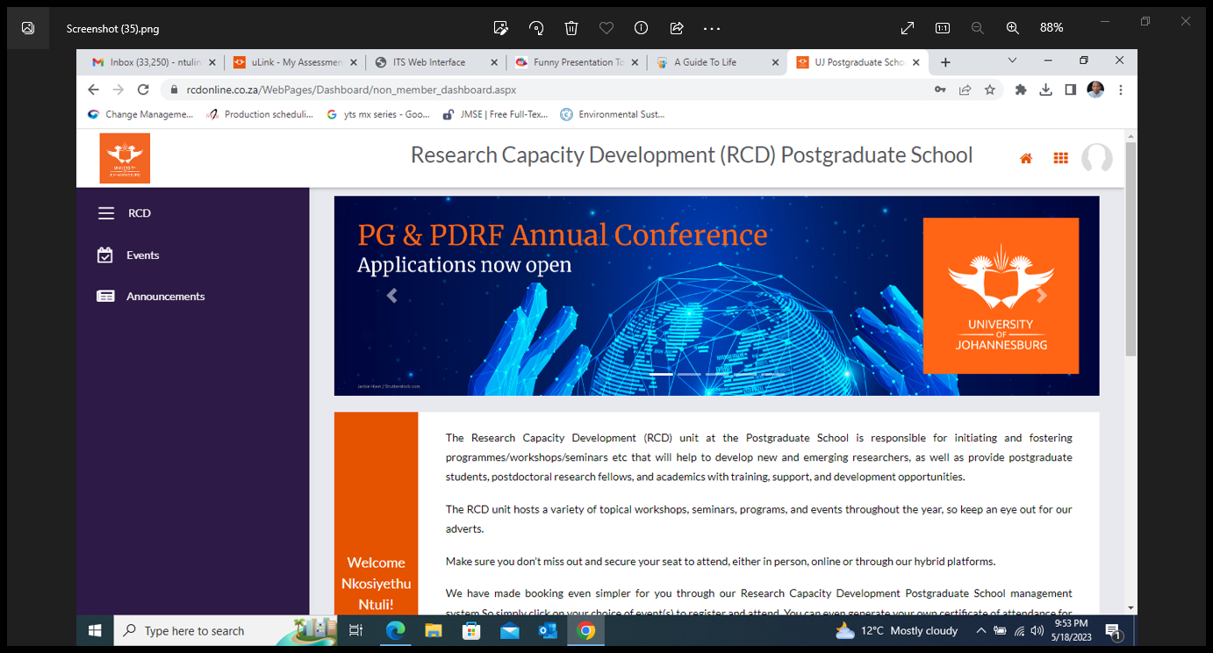
10. Select Events to view the 3MT competition event details

Slide 10
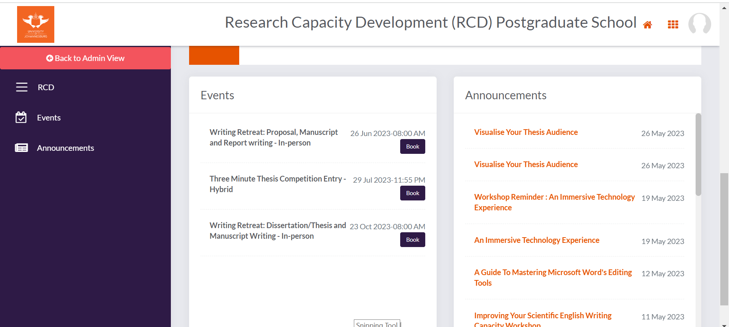
10.1 Select the Three Minute Thesis Competition Entry

Slide 11
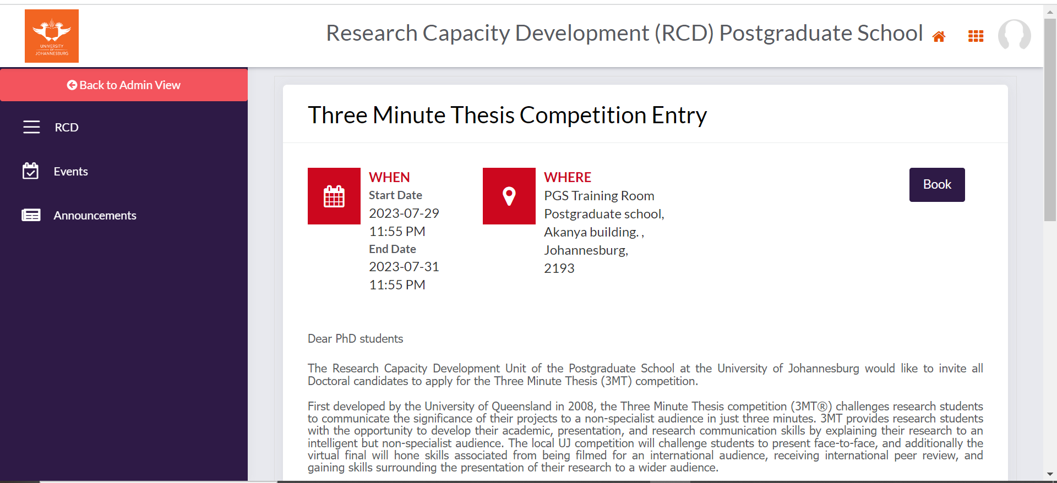
11. Verify personal details to submit and book your entry
11.1. Add your abstract template and 3MT slides template

Slide 12
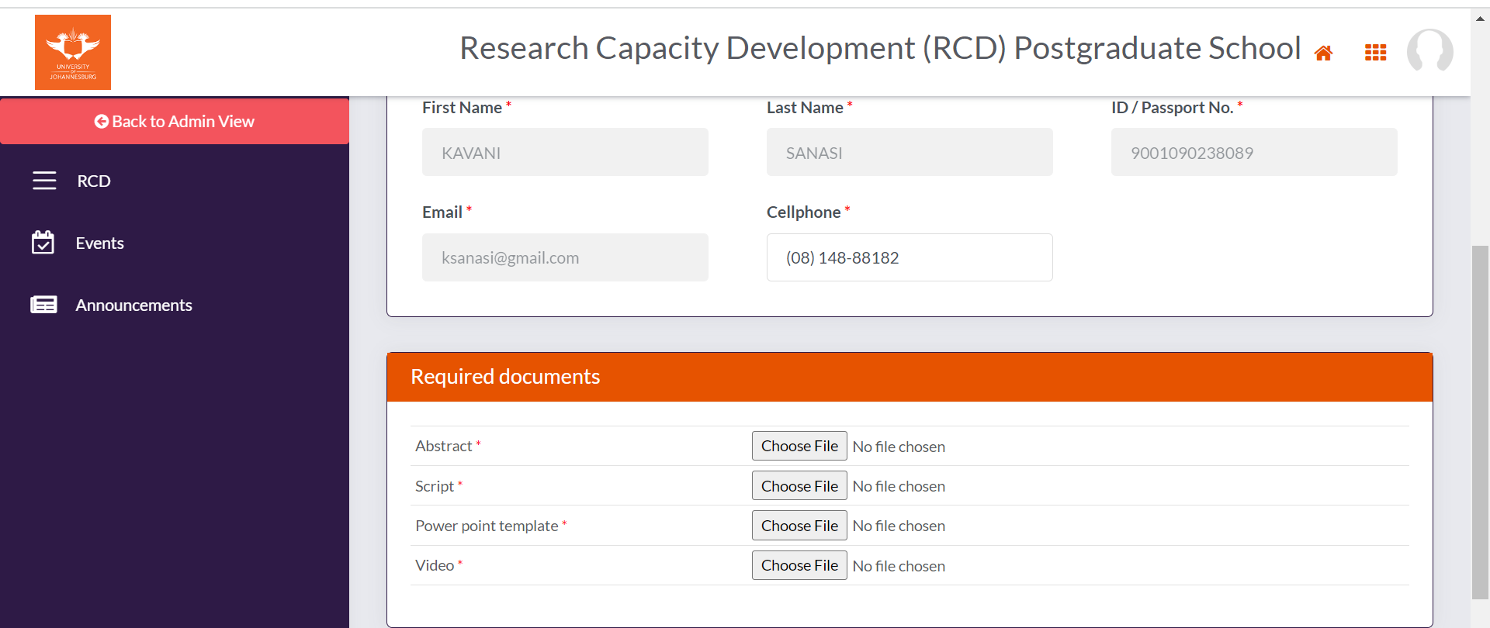
12. Accept Terms and Conditions and click Proceed

Slide 13
13. You have successfully registered for the competition

